Slide 1

Unit 3:- HYBRID AND ELECTRIC DRIVETRAINS

Slide 2
Battery charging Technologies
Medium of charge Transfer:
Conductive(wired)
Wireless(WPT)
Conductive(wire):Wired power transfer or charge transfer is conductive in nature
ADVANTAGE:
It's very simple, low cost, and It has high efficiency
DISADVANTAGE:
very inconvenient
Need to carry the charging cables and
risk of electrical shock to the operator

Slide 3
Wireless(WPT):
Advantage:
Very convenient
operator is free from electrical shock
DISADVANTAGE:
High installation cost, because of the hardware involved
Chances of high power loss, which will decrease the charging efficiency

Slide 4
Different methods of implementing wireless power transfer
Far-field strategies :
Near-field strategies
Far-field strategies :
Uses high frequency and it can transfer high power at long distances
It is based on microwave or laser type of technology.
This technology is not suitable for EV, because it involves tracking strategies, antennas, and it's also prone to human health.
Near-field strategies:
CAPACITIVE
INDUCTIVE

Slide 5
CAPACITIVE:
Capacitive method uses electric field to transfer the charge to the battery
unaffected by metal barriers and it also does not emit any EMI problems
capacitive type of wireless power transfer is suitable for low power application and it is not suitable for a typical EV application
INDUCTIVE:
EMI is in magnetic based inductive systems
But this technology is very sensitive to air gap and the displacement of the charging plates
Iductive based mechanically coupled wireless power transfer promises a very good technology for wireless power transfer
It uses a phenomenon known as magnetic resonant coupling or MRC such that the high power can be transferred in the range 10s of KW over 10s of cm
Iinevitable, the inductive schemes may suffer EMI issues
It also suffers from energy loss due to leakage inductances.

Slide 6
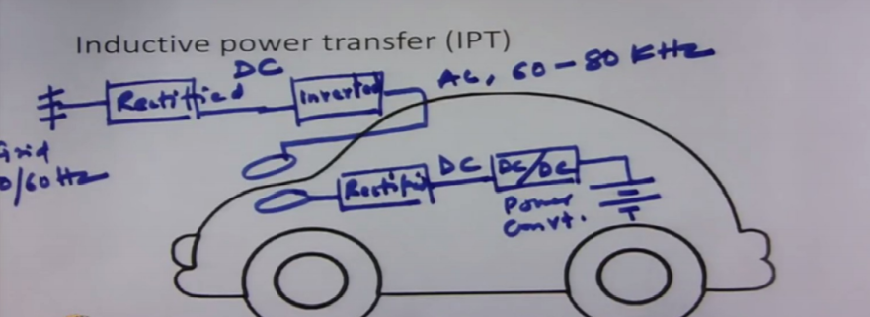
Inductive Power Transfer

Slide 7
Scheme of inductive power transfer.
It transfers energy through inductive coupling
There will be two coils, one on the charging coupler and one inside the vehicle
Power is taken from the grid(50 to 60 Hz), is rectified and converted to DC voltage, it is inverted using an inverter and AC voltage is generated at very high frequency in the range of 60 to 80 KHz.
This high frequency enables a very small inductive coupler and the size of the coils can be reduced at this high frequency.
Power will be transferred using inductive medium and it is available on the secondary side, which is again rectified and converted to regulated DC
This DC voltage is used to charge the battery using DC-DC power converter

Slide 8
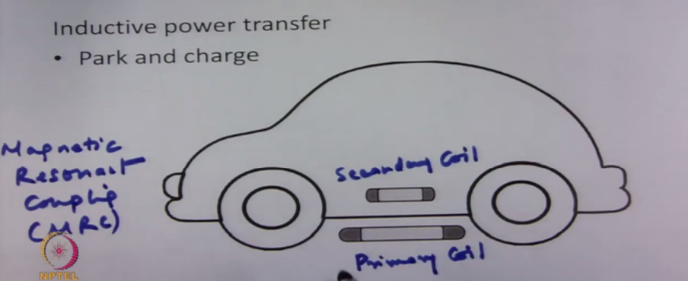

Slide 9
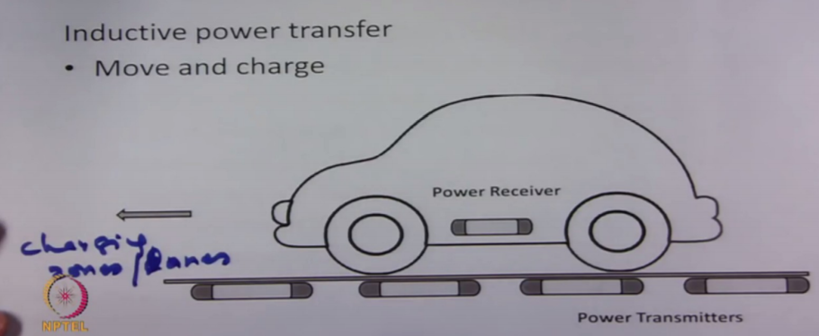

Slide 10
PARK & CHARGE
Inductive coils are installed on the floor of the parking area
Primary coil will be installed in the basement of the parking area and secondary coil will be installed on the chassis of the vehicle
Whenever vehicle is parked, an automatic charging can be enabled.
No inconvenience to the driver or the operator
Charging scheme uses magnetic resonant coupling phenomenon, such that power will be transferred efficiently and during power transfer the non resonant object such as metal body or the driver is unaffected by it.
Protection is kind of in-built in this kind of scheme.

Slide 11
MOVE & CHARGE
To charge this vehicle when they are plying on the road
Done at charging zones or lanes in some areas of the city, where lot of primary coils will be installed over half a km or 1 km
when vehicle move on this kind of lanes the power will be transferred to the vehicle using inductive phenomenon
Advantages : vehicle can be charged
On the go
Battery size can be less
Anxiety of driving range will also be minimized

Slide 12
MOVE & CHARGE
IMPLEMENTATION REQUIREMENT:
Charging scheme may observe different resonant frequencies because of the vertical distance and the horizontal distance.
This primary and secondary or the transmitter receiver observes, when the vehicle is moving. Therefore, the power transmitters should be able to be configured dynamically such that the coupling can be maximum and the power transfer can be maximum.
Secondly, when such a charging zone or lanes were developed, they should consider a uniformity in the magnetic field all around the road, such that the coupling can be same and charging can be done properly with high efficiency.
Communication protocol has to be developed such that the vehicle that are meant to be charged are only charged and not all the vehicles.
Since the battery energy storage capacity is limited, it is always a important aspect to manage the battery and energy associated with the battery.

Slide 13
Battery Management system (BMS) for EV and HEV
Measures voltage, current , temprature data in real time system and log it for the following:
Cell balancing, Thermal management
Protections: overvolatage, overcurrent & overheat
State of charge(SOC)
State of health ( SOH)
State of Power ( SOP)

